Slide 1
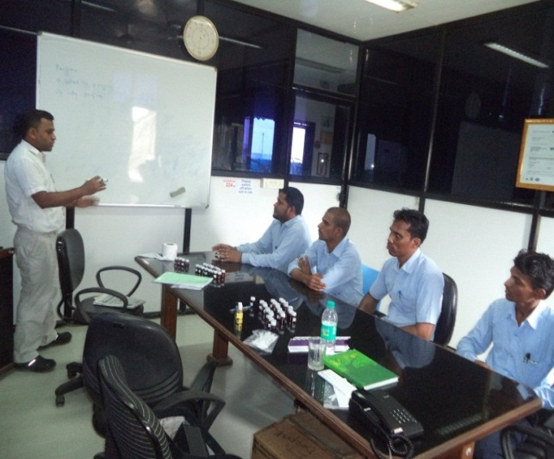
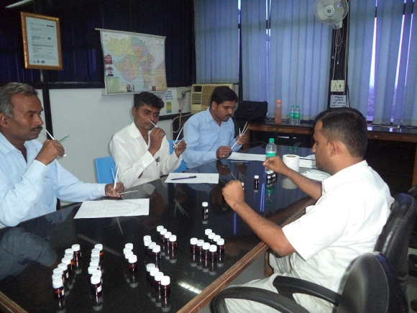

Achievements. Project Owner CMB Head Mr. Pratyaya Chakrabarti
Olfactory team developed at Daman Location.
After two days exercise, 5 candidate selected for organoleptic test.
Team has started to observe/Monitor organoleptic test for each product .

